Slide 1
Motion Estimation Via cluster matching
By
Name: Pravin Reddy Sereddy
B-number: B00714266
B-mail: spravin1@Binghamton.edu

Slide 2
Table of Contents
What is motion estimation?
Why we do we need motion estimation?
What is motion estimation via clustering Matching?
Motion estimation via clustering Matching Advantages over other approaches
Implementation
Clustering
Matching
Results
References

Slide 3

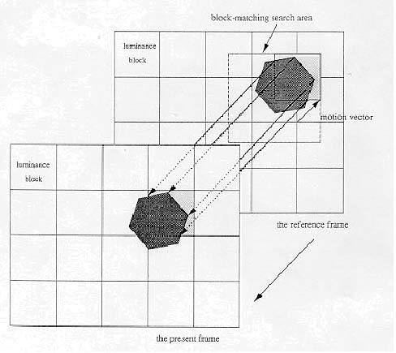
What is motion estimation?
Motion estimation is the process of determining motion vectors that describe the transformation from one 2D image to another; usually from adjacent frames in a video sequence

Slide 4
Why do we need motion estimation?
Estimation of the two-dimensional motion field from an image sequence is a common problem in computer vision applications such as autonomous navigation, satellite imagery analysis, medical imaging analysis and for the video coding such as MPEG

Slide 5
What is motion estimation via clustering Matching?
In the past, many researchers contributed to the extraction of optical flow through image sequences based on models of the object and the illumination condition
In this Project clustering is used to group pixels with similar feature‘s in each image frame
The displacements are estimated by matching clusters between two frames in the image sequence

Slide 6
motion estimation via clustering Matching Advantages over the other approaches
Clustering is performed directly in the image space before the velocity field is identified
This process requires very little a priori knowledge of the content of the image scene or the type of motion
Specifically, no assumptions regarding object rigidity, brightness constancy and scene illumination are needed
This method should also be applicable to motion estimation for images containing deformable objects with varying brightness

Slide 7
Implementation
This process is a two-step process
First, pixels in each image frame are clustered using the k means clustering algorithm for the two successive image frames independently using the position and intensity of the pixels
Second step clusters are matched between the two consecutive frames using the position and the intensity, the shape of each cluster and the average gray-scale difference between two clusters are used as matching criteria
The displacement between the two matching cluster centers is assigned to every pixel in the cluster and this results in a dense set of displacement estimates

Slide 8


Clustering
The clustering algorithm is thought of variation of the k-means clustering algorithm
Each pixel is considered as 3D vector
Initially, clusters are created by partitioning the image into k square regions
Each cluster is defined by the means of the
Each cluster is centered at mx, my position and mz is the sample mean of gray-scale in each cluster

Slide 9

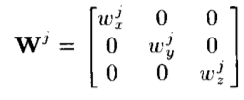
Clustering (cont’d)
After the initial clusters are determined, an iteration sequence commences where in each pixel is assigned to a cluster based on a weighted squared Euclidean distance criterion
Each pixel is assigned to cluster if is a minimum
The iteration stops when the maximum shift of the cluster centers drops below a specified value
Where W^{j} is a weight matrix

Slide 10



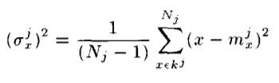
Clustering (cont’d)
W^{j} is determined by minimizing the intra set distance between the pixels in cluster k subjected to constraint that
The weights are given by
Unbiased variance estimate of the pixels in a cluster
in x direction

Slide 11
Clustering (cont’d)
N_{j} is the number of pixels in cluster in kj
Unique set of weights is calculated for each cluster rather than assigning one set of weights for all clusters
The purpose of the weighting matrices is to balance the emphasis of position and intensity in the cluster
Therefore, it is important to recalculate Wj periodically to adapt to changes in the cluster contents

Slide 12

Cluster Matching
Once both the images are clustered, we two sets of clusters, one for each image
Clusters at the time t image frame is
Clusters at the time t + dt image frame is
To find accurate matches, two features are added to the means of the position and intensity of the clusters

Slide 13
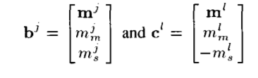

Cluster Matching (cont’d)
Let bJ be the vector of matching features for cluster kj and, cl denote the vector of matching features for kj
Where average grayscale difference in the cluster kj

Slide 14
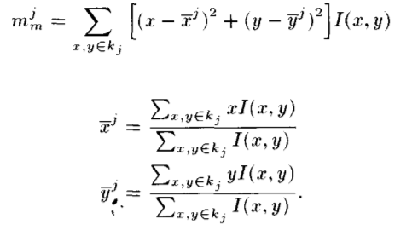
Cluster Matching (cont’d)
The sum of the squared central moments in the z and y direction is defined by
Squared central moments are never changed to translation and rotation and represent the shape information of each cluster

Slide 15
Cluster Matching (cont’d)
Each matching feature contributes to the correct match
For clusters with different intensities, but the same shape and equal displacements, the mean intensity values (m_{z}) influence the matching problem
If the moving clusters have the same intensities and equal displacements but different shapes, the shape information held in the values of the squared central moments (m_{m}) contributes strongly to the correct match
Finally, when clusters have the same shape and intensity, but one is stationary, while the other moves, the difference averages (m_{s}) help determine the correct match

Slide 16


Cluster Matching (cont’d)
As in clustering, the matching criteria is a weighted squared Euclidean distance measure
The index I that results in the minimum value of D^{jl} defines the match of cluster k^{j} and k^{l}
Where U is the 5x5 diagonal matrix has u_{x}, u_{y}, u_{z}, u_{m}, u_{s}
The matching procedure is a two-step iteration process: weight determination followed by cluster matching

Slide 17
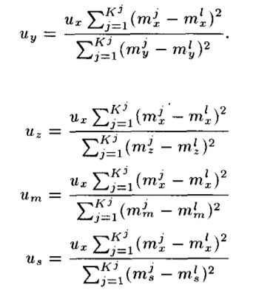
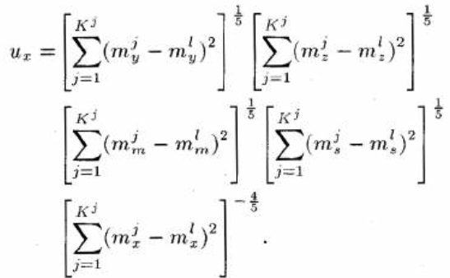
Cluster Matching (cont’d)
finding the u_{x}, u_{y}, u_{z}, u_{m}, u_{s}
For every iteration, the weights are recalculated so that the total displacement of the cluster centers is minimized.

Slide 18

Cluster Matching (cont’d)
From the set of cluster center matches, the displacement estimates for each pixel in the cluster are obtained via
From this values we draw the motion vectors on the image for the moving object

Slide 19
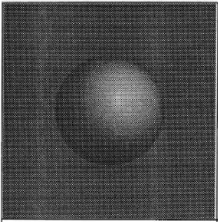
Results
An image is given 256 x 256 x 8-bit synthetic-sphere image
To cluster this image, we used k = 36 initial regions
The image took 29 iterations until the maximum shift of the cluster centers was less than 1.0 pixel

Slide 20
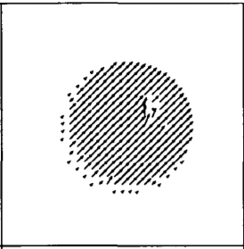
Results (cont’d)
The sphere was moved seven pixels up and seven pixels to the right; the result of displacement estimates by the cluster matching algorithm

Slide 21
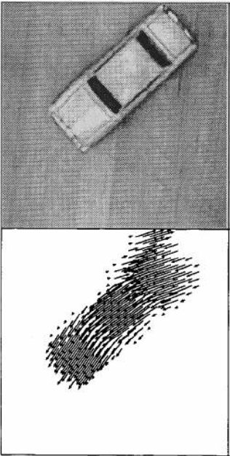
Results (cont’d)
A frame from the moving model-car sequence
Where k = 25 and the weights are recalculated every 10 iterations and it took 24 iterations to process the image

Slide 22
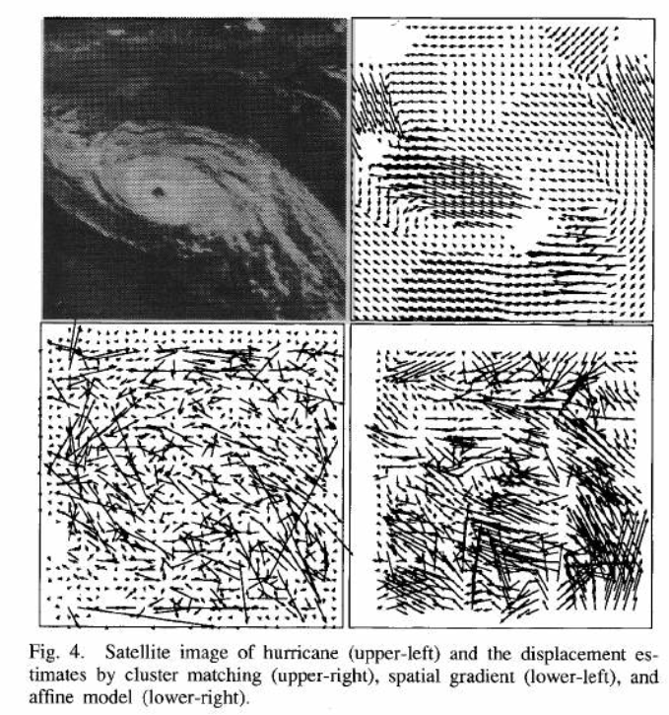
Results (cont’d)

Slide 23
References
Dane P. Kottke, Ying Sun, “Motion Estimation Via Cluster Matching” IEEE Transactions on Pattern Analysis and Machine Intelligence, VOL. 16, NO. 11, November 1994
J. K. Agganval and N. Nandhakumar, “On the computation of motion from sequences of images-A review,” Proc. IEEE, vol. 76, pp. 917-935, 1988
J. Tou and R. C. Gonzalez, Pattern Recognition Principles. Reading, MA: Addison-Wesley, 1974
https://en.wikipedia.org/wiki/Motion_estimation

Slide 24
Questions?

Slide 25
Thank You

